Slide 1

Using RRT Algorithm for Exploration of Unknown Environment
Project 5 Presentation
ENPM661 Spring 2022
Project 5
Jerry Pittman (117707120)
Maitreya Kulkarni (117506075)

Slide 2
Using RRT Algorithm for Exploration of Unknown Environment
Rapidly-exploring Random Tree (RRT) is a data structure and algorithm that is designed for efficiently searching nonconvex high-dimensional spaces.
RTs are particularly suited for path planning problems that involve obstacles and differential constraints. This means that RRT is suitable for systems with nonholonomic constraints.
RRT for SLAM: RRT to mobile robots in such a way enables us to create a self-exploring autonomous robot with no human interventions required. The nature of the algorithm tends to be biased towards unexplored regions which become very beneficial to environment exploring tasks.

Slide 3
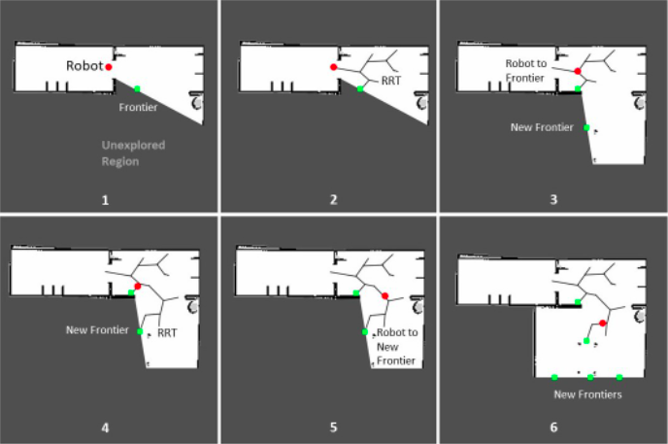
Using RRT Algorithm for Exploration of Unknown Environment

Slide 4
Using RRT Algorithm for Exploration of Unknown Environment
This method had two frontiers that explore the unknown parts of the environment.
Local Frontier detector: This detector explores nodes and checks whether the node lies in unknown space or not and if it lies in unknown space it checks for occupancy grid values for obstacle location. Resets every time after exploring vertices and starts growing again from robot’s position.
Global Frontier detector: This detector keeps exploring the nodes and doesn’t stop even if the part of the environment has been explored or not.

Slide 5
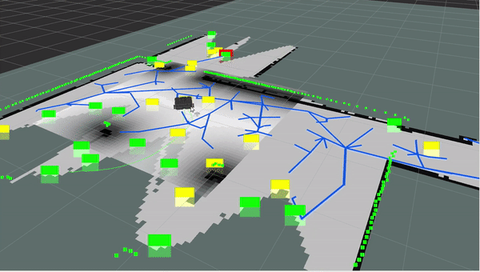
Map the Environment using RRT (video)

Slide 6
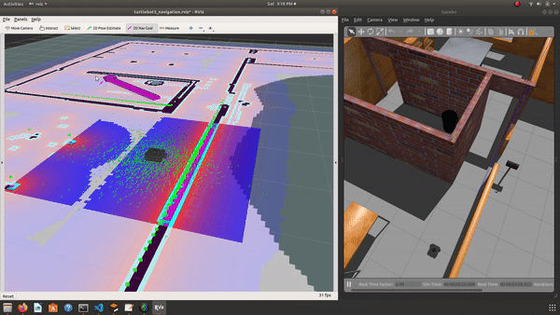
Go to Goal(s) using RRT maps generated (video)

Slide 7
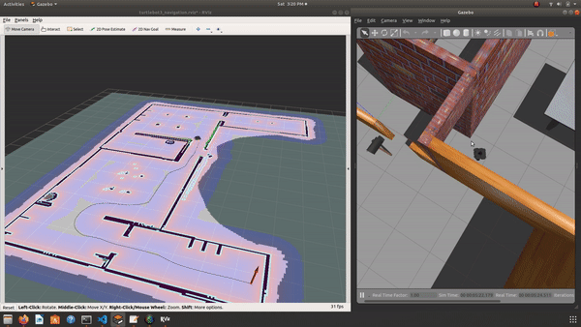
Go to Goal(s) using RRT maps generated (video)

Slide 8
Issues
Displaying the RRTs (global and local) as well as the open/closed nodes in RVIZ
Having the robot move autonomously after mapping the environment to ensure entire map is discovered/mapped (sourcing issue plus not plotting the publish points correctly for boundaries of RRT/A-star)

Slide 9
References
[1] M. Fazil. “Ros autonomous slam using rapidly exploring random tree (rrt).” (), [Online]. Available: https : / / towardsdatascience . com / ros - autonomous - slam - using - randomly -exploring-random-tree-rrt-37186f6e3568?gi=23ca649017c0. (accessed: 04.04.2022).
[2] J. Ibarra-Zannatha, J. Sossa-Azuela, and H. Gonzalez-Hernandez, “A new roadmap approach
to automatic path planning for mobile robot navigation,” in Proceedings of IEEE International Conference on Systems, Man and Cybernetics, vol. 3, 1994, 2803–2808 vol. 3. doi: 10 . 1109 /ICSMC.1994.400298.
[3] M. Kulkarni and J. Pittman. “Enpm661 project 5.” (), [Online]. Available: https://github.com/jpittma1/ENPM661_Project5_RRT.git. (accessed: 04.04.2022).
[4] I. Noreen, A. Khan, Z. Habib, et al., “Optimal path planning using rrt* based approaches: Asurvey and future directions,” Int. J. Adv. Comput. Sci. Appl, vol. 7, no. 11, pp. 97–107, 2016.
[5] N. P ́erez-Higueras, A. Jard ́on, A. Rodr ́ıguez, and C. Balaguer, “3d exploration and navigation ́with optimal-rrt planners for ground robots in indoor incidents,” Sensors, vol. 20, no. 1, 2020, issn: 1424-8220. doi: 10.3390/s20010220. [Online]. Available: https://www.mdpi.com/1424-220/20/1/220.
[6] H. Umari and S. Mukhopadhyay, “Autonomous robotic exploration based on multiple rapidly-exploring randomized trees,” in 2017 IEEE/RSJ International Conference on Intelligent Robots and Systems (IROS), 2017, pp. 1396–1402. doi: 10.1109/IROS.2017.8202319.

